Slide 1
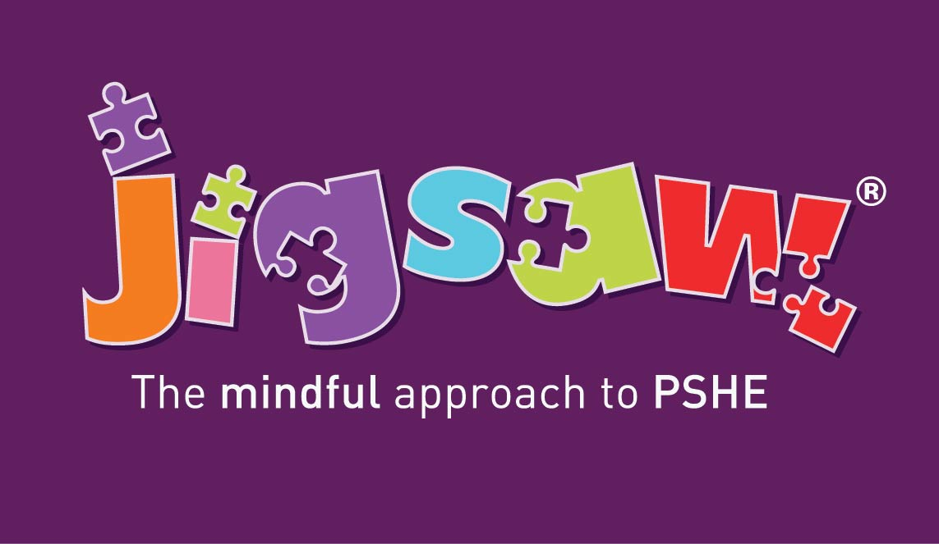
Consultation and Parental Engagement for RHSE
(Relationships, Sex AND Health Education)
How do we meet the statutory guidance in and make it meaningful for our school community?
Notes:
© 2021 Jigsaw PSHE Ltd
DO NOT REPUPLISH THIS POWERPOINT PRESENTATION
Due to copyrighted, licensed and trademarked content.
This presentation is intended and licensed for use internally for staff training purposes only.

Slide 2
This presentation outlines:
What the statutory expectations are for consultation and parental engagement on RSHE
Why this is important to your school community
How you can consult in a way that is meaningful for all
Where you can find additional support and information
Notes:
Replace the date and time of your webinar

Slide 3
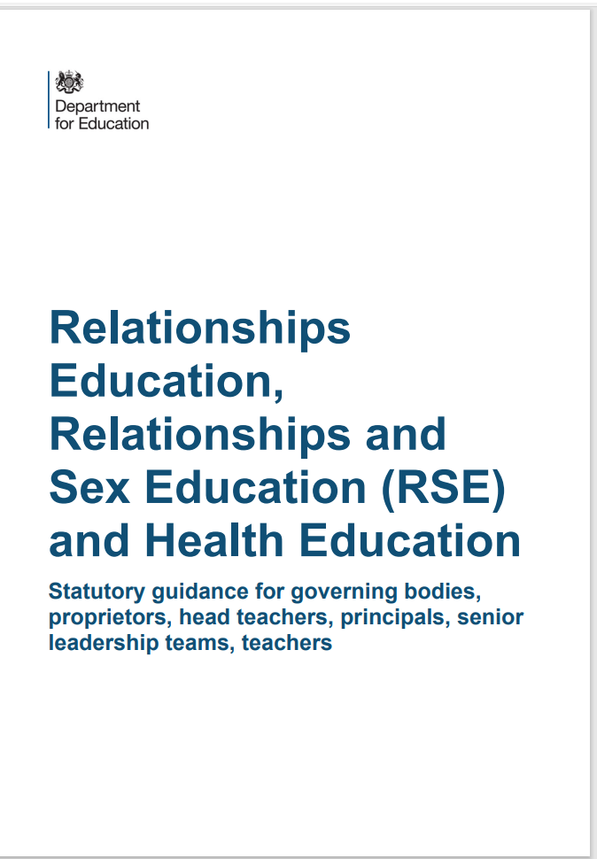
What do we have to consult on?
The DfE’s 2019 RSHE and RSE Guidance states in paragraph 13:
“All schools must have in place a written policy for Relationships Education and RSE. Schools must consult parents in developing and reviewing their policy. Schools should ensure that the policy meets the needs of pupils and parents and reflects the community they serve.”

Slide 4
We don’t do this for other subjects. Why RSE?
Confidence
Staff, governors and parents need to feel comfortable talking about any issues that come up, and the context in which we are discussing them
Shared Responsibility
Children learn about Relationships and other topics in PSHE at home. We need to build in opportunities throughout the academic year for parents to be informed about the topics we cover in class – consultation can help us find out the best ways to do this. Parents can then prepare their child when they feel they need to and support them with any further questions beyond the lesson itself.
Sensitive Subjects
The topics we discuss in RSE – and PSHE – can sometimes be sensitive. Consultation enables us to carefully consider different views and seek consensus.
Mutual Respect
We need to listen to and respect the views of our parents and carers in the same way as we respect the views of their children in our classrooms and demonstrate how we encourage our pupils to do the same.
Reassurance
We need to explain what we are actually teaching in school, and what we are not teaching. The myths and misinformation in the media are leading to very real parental fear which we can dispel early BEFORE we teach these topics.

Slide 5
Where you can find our policy and additional information
An updated copy of the RSE policy is available on the website for you to read through at your convenience.
We have also linked a copy to the DfE’s Statutory Guidance on the website in Curriculum and in PSHE.

Slide 6
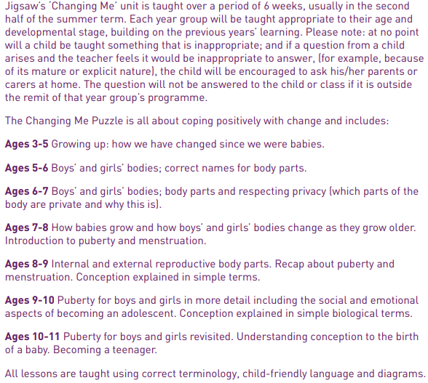
What will my child actually be taught about puberty and human reproduction? Progression from Early Years to Year 6.

Slide 7
Puberty and Human Reproduction in Jigsaw 3-11 Changing Me Puzzle
FS | Growing Up | How we have changed since we were babies
Y1 | My changing body | Understanding that growing and changing is natural and happens to everybody at different rates
 | Boys’ and girls’ bodies | Appreciating the parts of the body that make us different and using the correct names for them
Y2 | The changing me | Where am I on the journey from young to old, and what changes can I be proud of?
 | Boys and girls | Differences between boys and girls – how do we feel about them? Which parts of me are private?
Y3 | Outside body changes | How our bodies need to change so they can make babies when we grow up – outside changes and how we feel about them
 | Inside body changes | How our bodies need to change so they can make babies when we grow up – inside changes and how we feel about them (animations used – shorter version Female and Male Reproductive Systems)
Notes:
ALL THIS FALLS WITHIN THE STATUTORY HEALTH EDUCATION GUIDANCE…changing adolescent body so is compulsory.
More detail about exactly what is covered in each year group.
Emphasise that only 2 or 3 lessons in every year group are specifically about either puberty (statutory) or How babies are made (not statutory).
Also emphasise that correct terminology is introduced early so the school can meet its safeguarding obligations and to get the children used to using the words appropriately (ie we also teach them when it’s appropriate to use these words and when not). A further rationale for this is that in KS2, body part words are not seen as something rude or dirty.
Puberty is introduced very gently in Y3 because some girls may start their periods early and it is necessary to prepare them for this so they aren’t scared or worried.

Slide 8
Puberty and Human Reproduction in Jigsaw 3-11 Changing Me Puzzle
Y4 | Having a baby | The choice to have a baby, the parts of men and women that make babies and – in simple terms – how this happens (animations used – the Female Reproductive System)
 | Girls and puberty | How a girl’s body changes so that she can have a baby when she’s an adult – including menstruation (animations used – the Female Reproductive System)
Y5 | Puberty for girls | Physical changes and feelings about them – importance of looking after yourself (animations used – the Female Reproductive System)
 | Puberty for boys | Developing understanding of changes for both sexes – reassurance and exploring feelings (animations used – the Male Reproductive System)
 | Conception | Understanding the place of sexual intercourse in a relationship and how it can lead to conception and the wonder of a new life (animations used – the Female and Male Reproductive Systems)
Y6 | Puberty | Consolidating understanding of physical and emotional changes and how they affect us (animations used – the Female and Male Reproductive Systems)
 | Girl talk / boy talk | A chance to ask questions and reflect (single sex) (animations used – the Female and Male Reproductive Systems)
 | Conception to birth | The story of pregnancy and birth (animations used – the Female and Male Reproductive Systems)
Notes:
Notes:
Conception is introduced age appropriately in Y4 in the context of why our bodies change during puberty.
THERE IS AN ALTERNATIVE LESSON AVAILABLE IN YEAR 4 FOR SCHOOLS WHO DO NOT WISH TO TEACH THIS IN YEAR 4. If you decide not to teach conception in year 4, remember to change this slide!
Note that one lesson in Y4 is called Puberty for girls, this doesn’t exclude the boys, it covers them too, but the main focus is on menstruation.
Conception and puberty is built upon in Year 5 and then puberty, conception and childbirth is covered in more detail (but still age-appropriately) in Y6 with a chance for single gender group lessons (up until this point lesson shave all been mixed gender).
Remind the parents/carers that when moving to secondary school Sex Ed is compulsory so there is an expectation that children will be moving into Y7 with some knowledge.

Slide 9
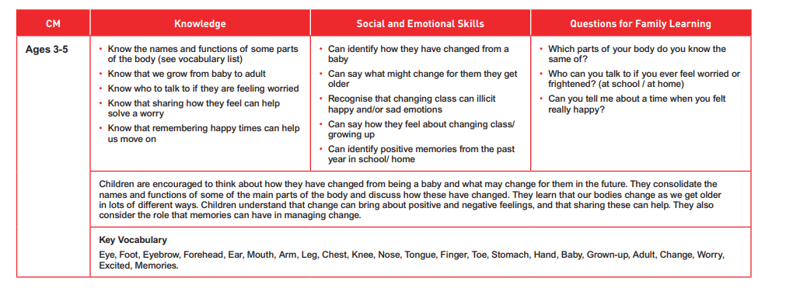

Slide 10
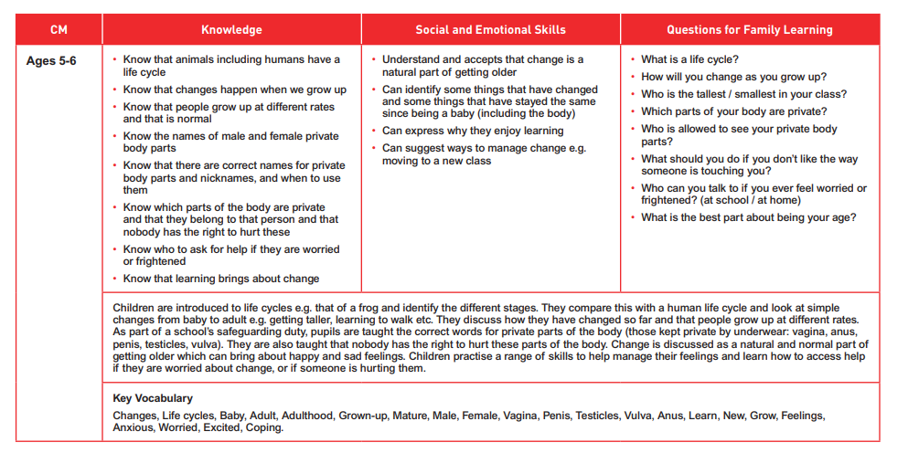

Slide 11
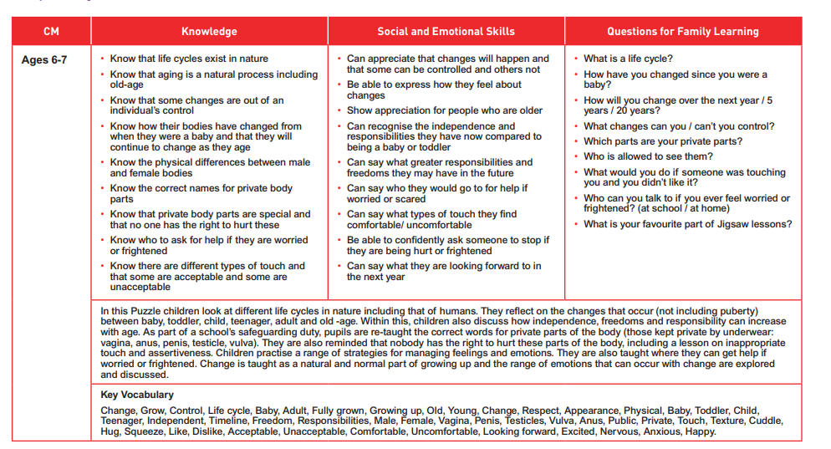

Slide 12
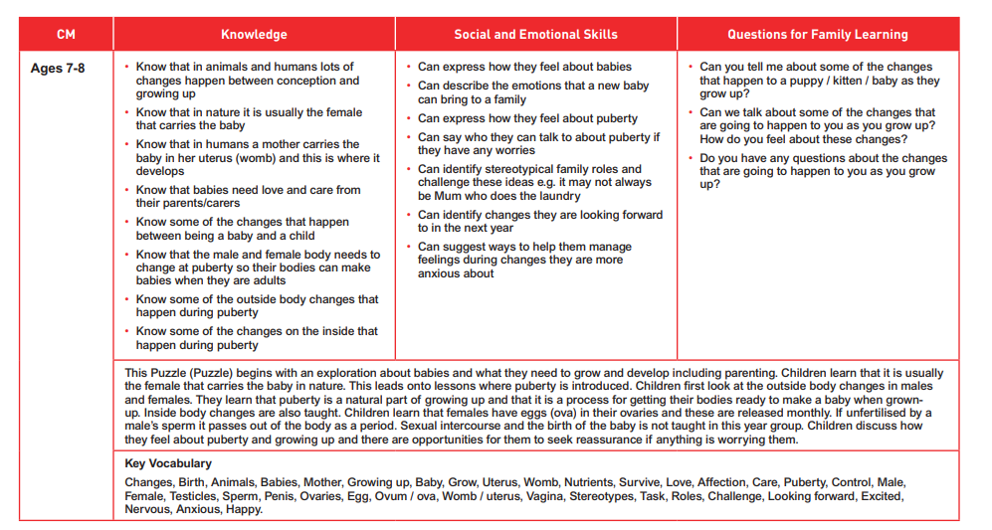

Slide 13
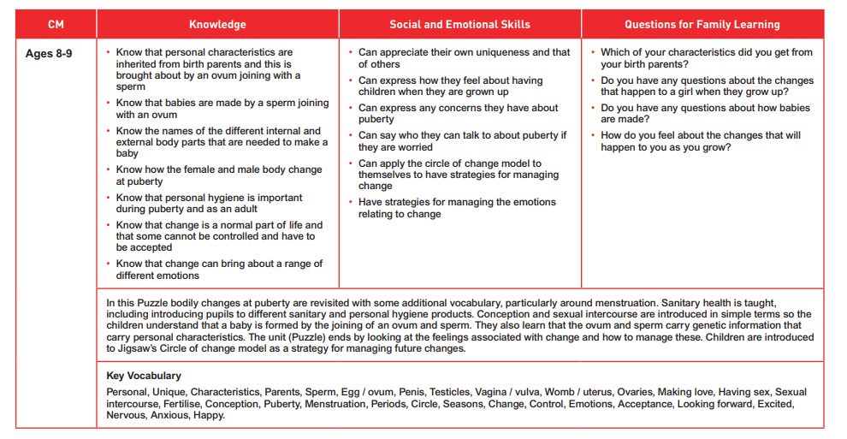

Slide 14
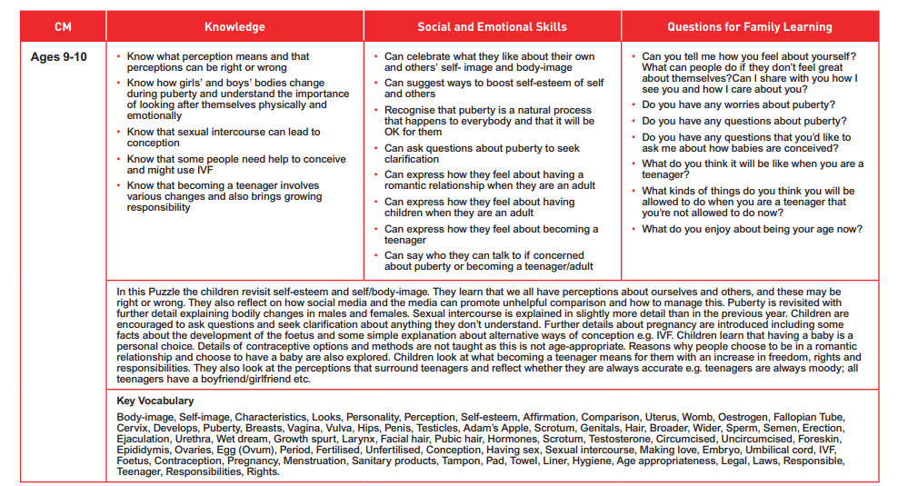

Slide 15
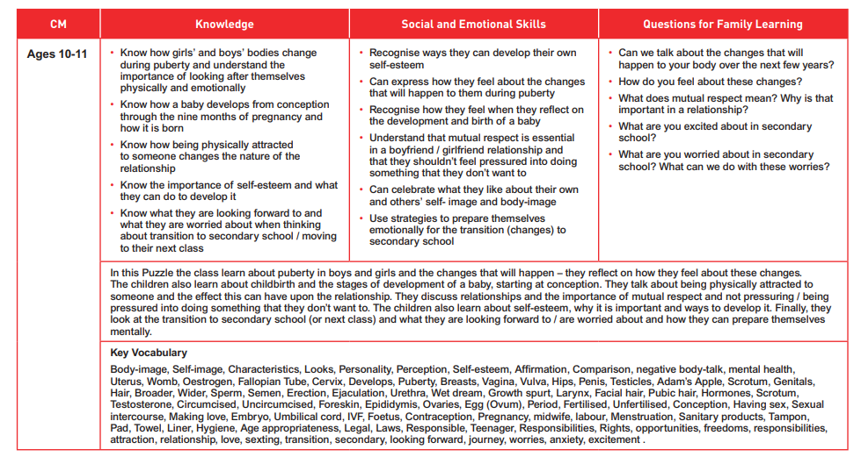

Slide 16
Piece 1 – Self image and body image
Outcomes:
Be aware of my own self-image and how my body image fits into that
Know how to develop my own self esteem.
Learning:
Children will have a discussion about self image and those of celebrities and what is real and is not real.
We will discuss positive and negative self image
We will use affirmations to help transform negative self image.

Slide 17
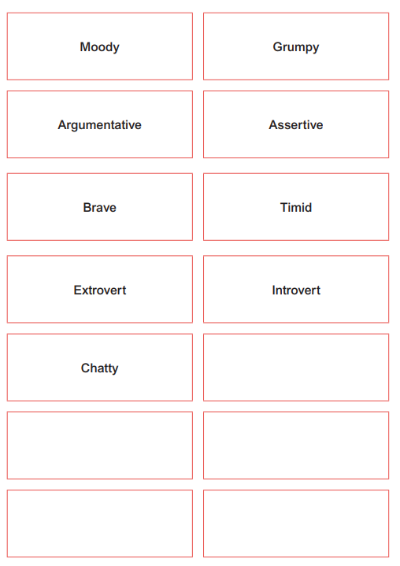
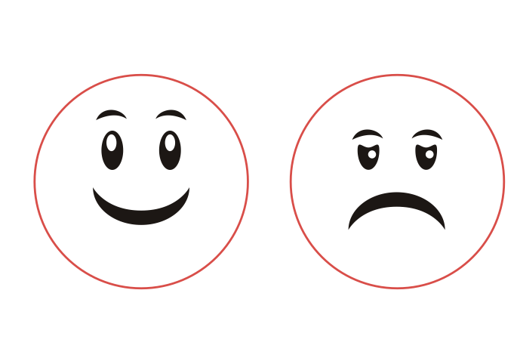
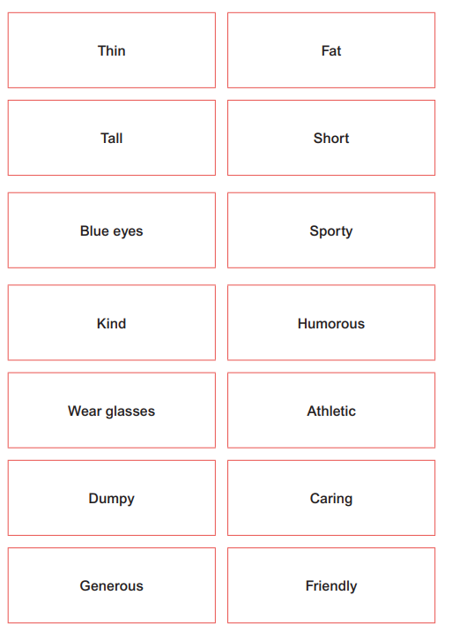
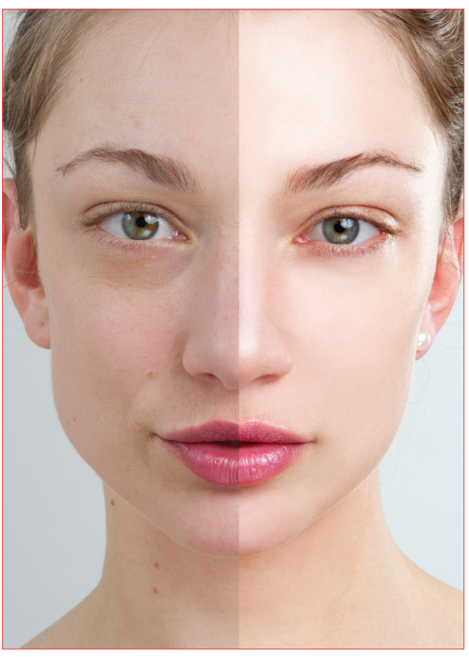
Piece 1 - Images

Slide 18
Piece 2 – Puberty for Girls
Outcomes:
Explain how a girl’s body changes during puberty and understand the importance of looking after myself physically and emotionally
Understand that puberty is a natural process that happens to everybody and that it will be OK
Learning:
Children will be taught how a baby is made
This will then progress into the menstruation cycle

Slide 19
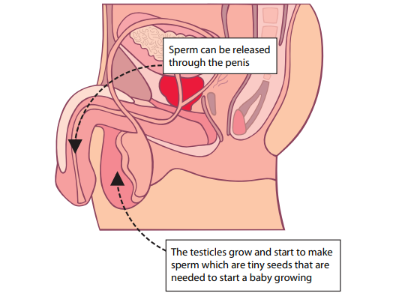
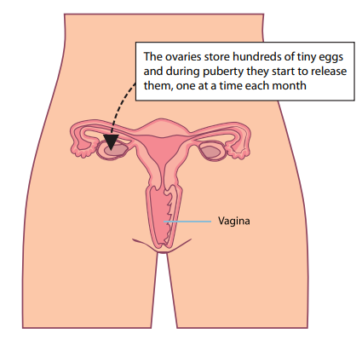
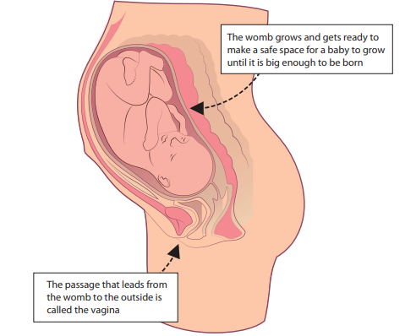
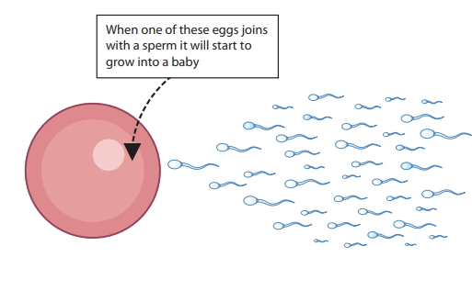
Piece 2 - Images

Slide 20
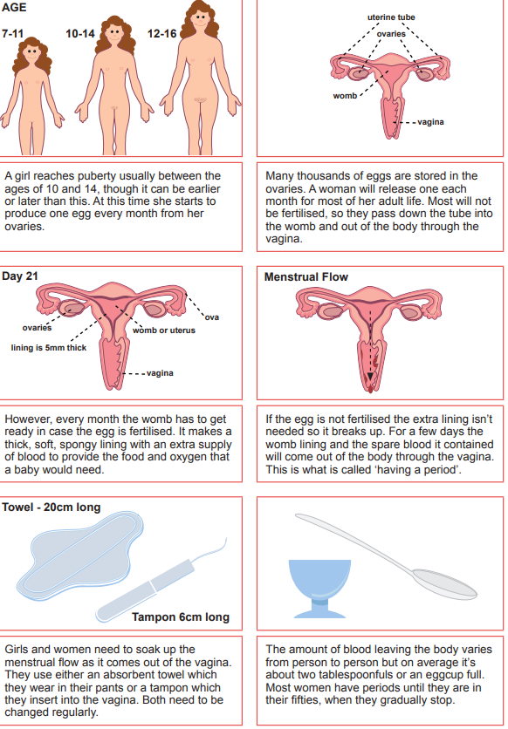
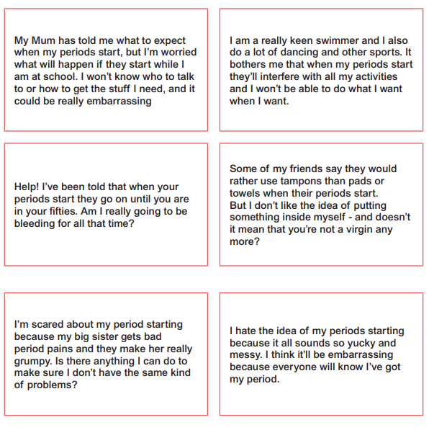
Piece 2 - Images

Slide 21
Piece 3 – Puberty for Boys
Outcomes:
Describe how boys’ and girls’ bodies change during puberty
Express how I feel about the changes that will happen to me during puberty
Learning:
Children will be taught the male reproductive organs
Children will create a leaflet on how puberty happens to us all

Slide 22
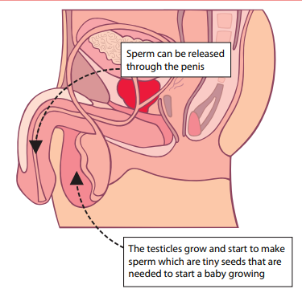
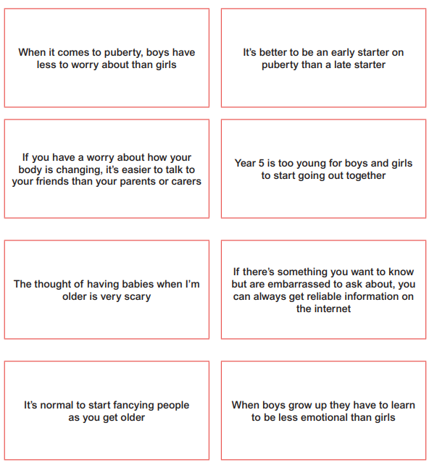
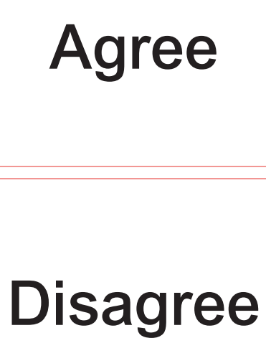
Piece 3 - Images
(Please add your year groups resources and lesson outcomes to the next few slides!

Slide 23
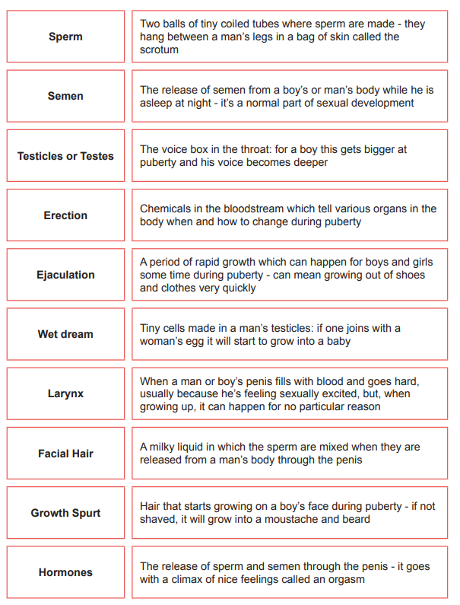
Piece 3 - Images
(Please add your year groups resources and lesson outcomes to the next few slides!

Slide 24
Piece 4 - Conception
Outcomes:
Understand that sexual intercourse can lead to conception and that is how babies are usually made
Understand that sometimes people need IVF to help them have a baby
Appreciate how amazing it is that human bodies can reproduce in these ways
Learning:
Discussion about relationships, when a couple decide to have a baby and the word ‘conception’
Recap on the male and female reproductive systems
Discussion about ‘Truth of Pregnancy and Concenception’

Slide 25
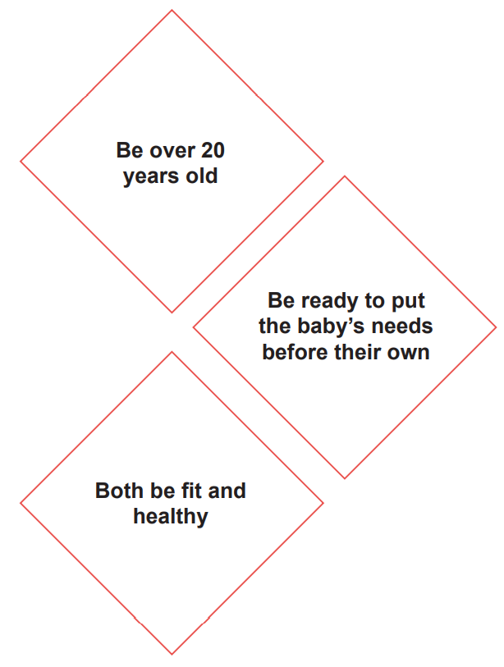
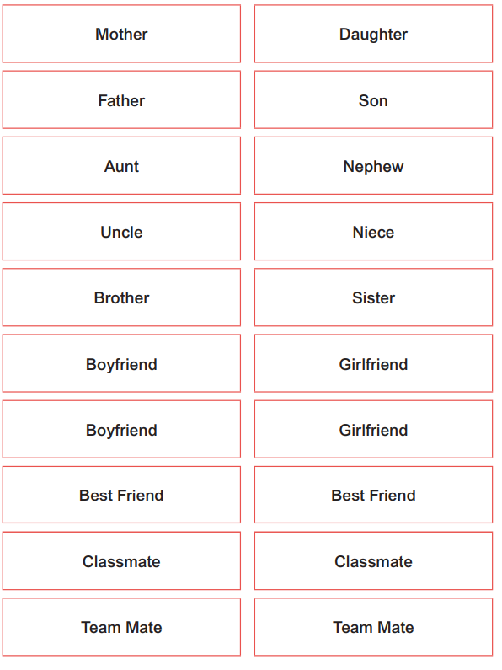
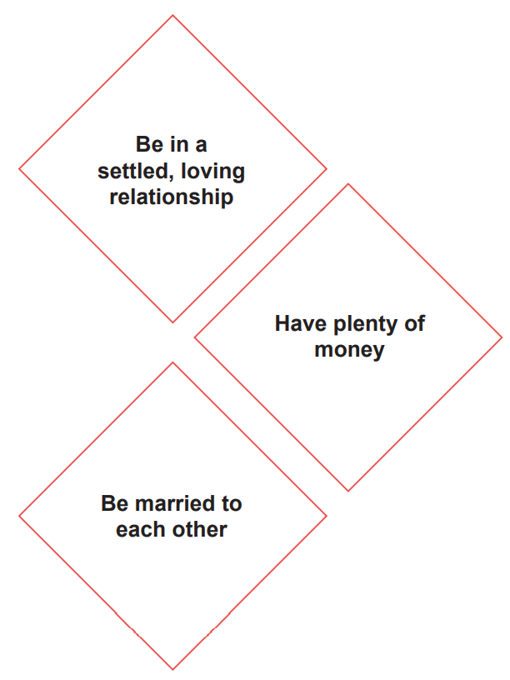
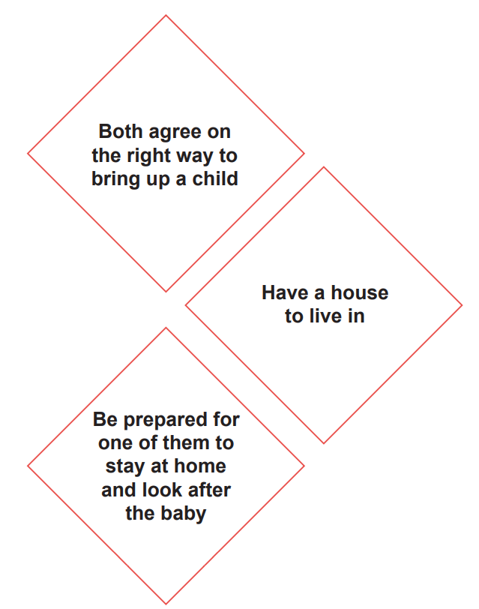
Piece 4 - Images

Slide 26
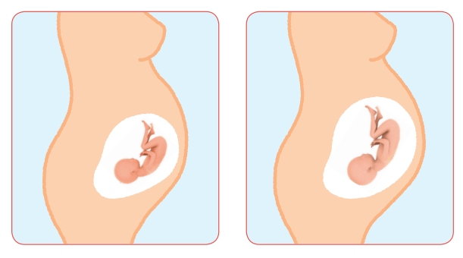
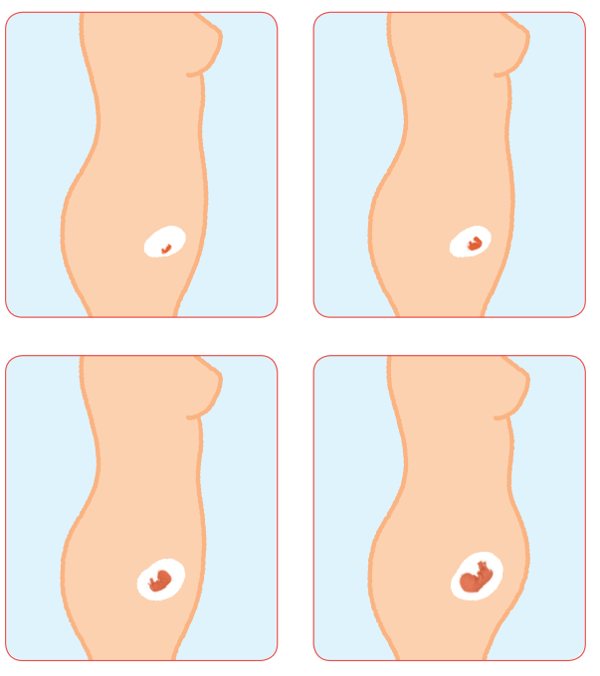
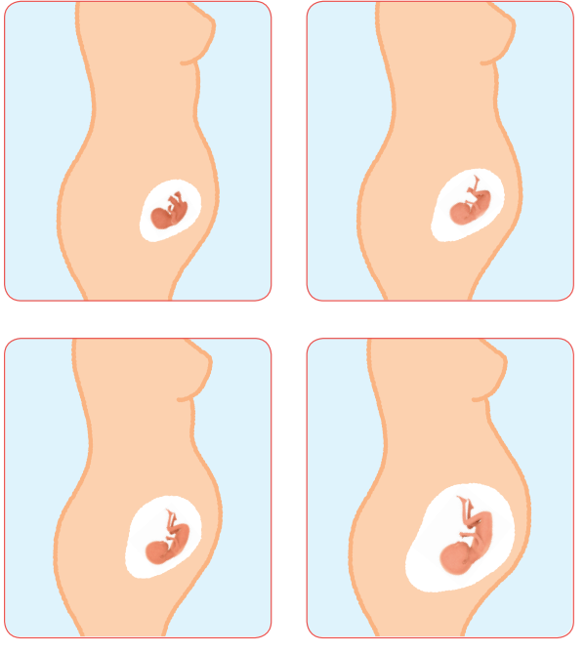
Piece 4 - Images

Slide 27
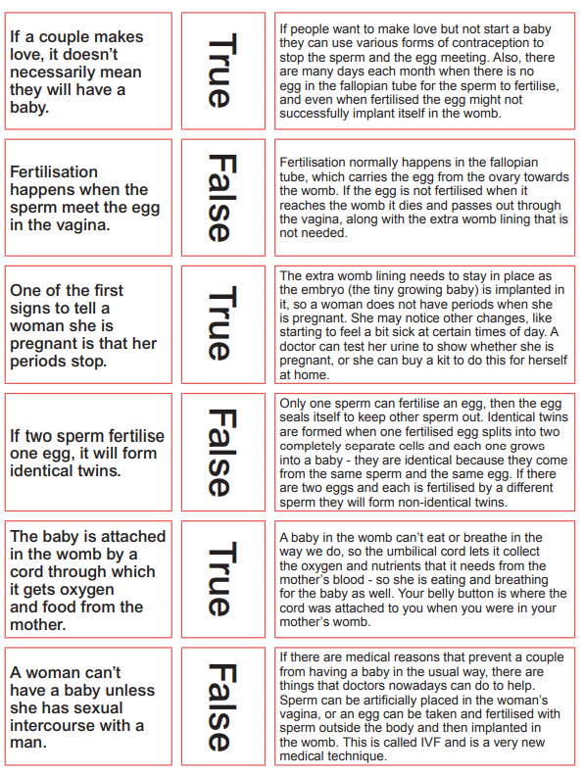

Slide 28
Piece 5 – Looking Ahead
Outcomes:
Identify what I am looking forward to about becoming a teenager and understand this brings growing responsibilities (age of consent)
Be confident that I can cope with the changes that growing up will bring
Learning:
Discussion about becoming a teenager (13) and perceptions of teenagers
Growing up brings increased responsibilities eg. changes during puberty may be hard for some children

Slide 29
Piece 6 – Looking ahead to Year 6
Outcomes:
Identify what I am looking forward to when I am in Year 6
Start to think about changes I will make when I am in Year 6 and know how to go about this
Learning:
Discussion about what we’re looking forward to and why we might be a little nervous

Slide 30
Can parents withdraw their children from RSE?
From September 2020…
(Government guidance 2019 page 17)
“Parents have the right to request that their child be withdrawn from some or all of sex education delivered as part of statutory RSE”.
NOT from Relationships or Health Education.
So, this session is to inform you of what this school defines as Sex Education,
what we intend to teach in RSHE and why…
…so you can make this decision.

Slide 31
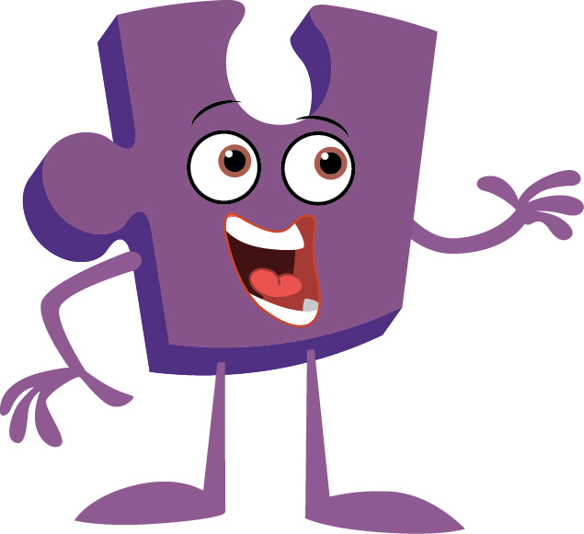

Any questions?

Slide 32

Thank you!

