Slide 1
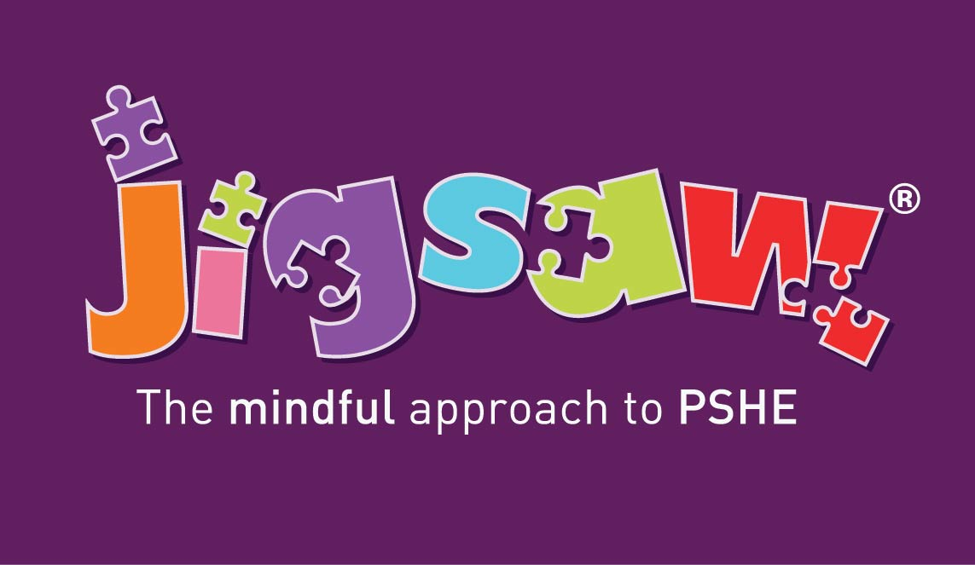
Consultation and Parental Engagement for RHSE
(Relationships, Sex AND Health Education)
How do we meet the statutory guidance in and make it meaningful for our school community?
Notes:
© 2021 Jigsaw PSHE Ltd
DO NOT REPUPLISH THIS POWERPOINT PRESENTATION
Due to copyrighted, licensed and trademarked content.
This presentation is intended and licensed for use internally for staff training purposes only.

Slide 2
This presentation outlines:
What the statutory expectations are for consultation and parental engagement on RSHE
Why this is important to your school community
How you can consult in a way that is meaningful for all
Where you can find additional support and information
Notes:
Replace the date and time of your webinar

Slide 3
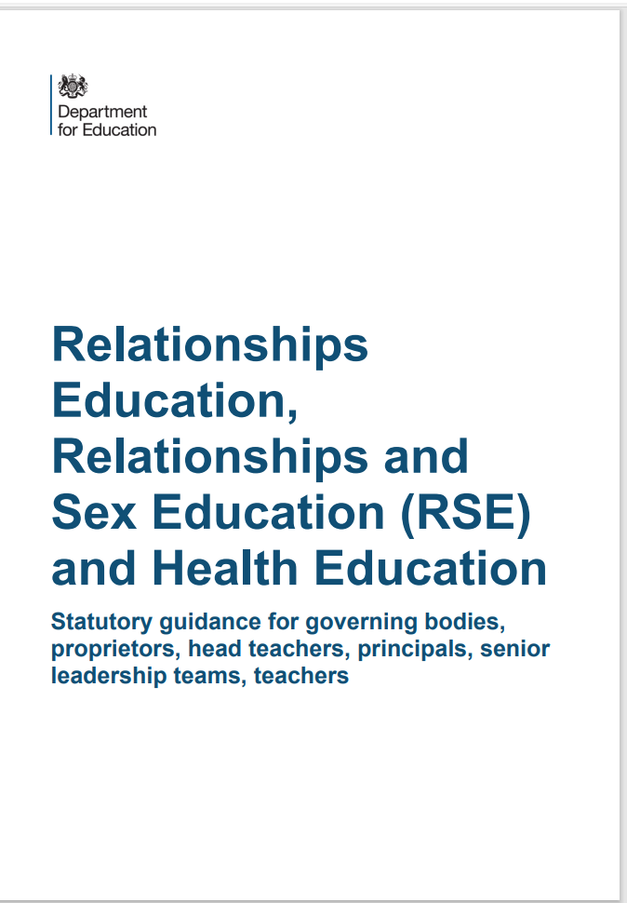
What do we have to consult on?
The DfE’s 2019 RSHE and RSE Guidance states in paragraph 13:
“All schools must have in place a written policy for Relationships Education and RSE. Schools must consult parents in developing and reviewing their policy. Schools should ensure that the policy meets the needs of pupils and parents and reflects the community they serve.”

Slide 4
We don’t do this for other subjects. Why RSE?
Confidence
Staff, governors and parents need to feel comfortable talking about any issues that come up, and the context in which we are discussing them
Shared Responsibility
Children learn about Relationships and other topics in PSHE at home. We need to build in opportunities throughout the academic year for parents to be informed about the topics we cover in class – consultation can help us find out the best ways to do this. Parents can then prepare their child when they feel they need to and support them with any further questions beyond the lesson itself.
Sensitive Subjects
The topics we discuss in RSE – and PSHE – can sometimes be sensitive. Consultation enables us to carefully consider different views and seek consensus.
Mutual Respect
We need to listen to and respect the views of our parents and carers in the same way as we respect the views of their children in our classrooms and demonstrate how we encourage our pupils to do the same.
Reassurance
We need to explain what we are actually teaching in school, and what we are not teaching. The myths and misinformation in the media are leading to very real parental fear which we can dispel early BEFORE we teach these topics.

Slide 5
Where you can find our policy and additional information
An updated copy of the RSE policy is available on the website for you to read through at your convenience.
We have also linked a copy to the DfE’s Statutory Guidance on the website in Curriculum and in PSHE.

Slide 6
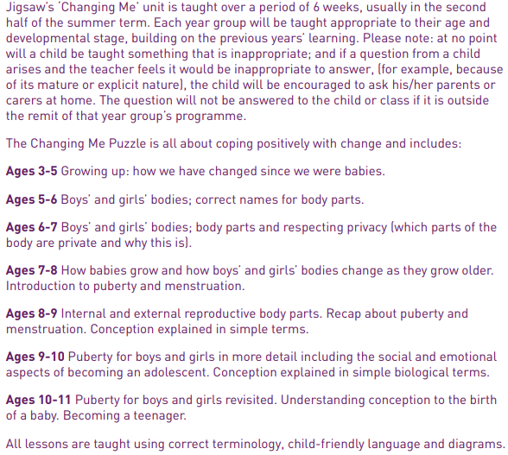
What will my child be taught about puberty and human reproduction? Progression from Early Years to Year 6.

Slide 7
Puberty and Human Reproduction in Jigsaw 3-11 Changing Me Puzzle
FS | Growing Up | How we have changed since we were babies
Y1 | My changing body | Understanding that growing and changing is natural and happens to everybody at different rates
 | Boys’ and girls’ bodies | Appreciating the parts of the body that make us different and using the correct names for them
Y2 | The changing me | Where am I on the journey from young to old, and what changes can I be proud of?
 | Boys and girls | Differences between boys and girls – how do we feel about them? Which parts of me are private?
Y3 | Outside body changes | How our bodies need to change so they can make babies when we grow up – outside changes and how we feel about them
 | Inside body changes | How our bodies need to change so they can make babies when we grow up – inside changes and how we feel about them (animations used – shorter version Female and Male Reproductive Systems)
Notes:
ALL THIS FALLS WITHIN THE STATUTORY HEALTH EDUCATION GUIDANCE…changing adolescent body so is compulsory.
More detail about exactly what is covered in each year group.
Emphasise that only 2 or 3 lessons in every year group are specifically about either puberty (statutory) or How babies are made (not statutory).
Also emphasise that correct terminology is introduced early so the school can meet its safeguarding obligations and to get the children used to using the words appropriately (ie we also teach them when it’s appropriate to use these words and when not). A further rationale for this is that in KS2, body part words are not seen as something rude or dirty.
Puberty is introduced very gently in Y3 because some girls may start their periods early and it is necessary to prepare them for this so they aren’t scared or worried.

Slide 8
Puberty and Human Reproduction in Jigsaw 3-11 Changing Me Puzzle
Y4 | Having a baby | The choice to have a baby, the parts of men and women that make babies and – in simple terms – how this happens (animations used – the Female Reproductive System)
 | Girls and puberty | How a girl’s body changes so that she can have a baby when she’s an adult – including menstruation (animations used – the Female Reproductive System)
Y5 | Puberty for girls | Physical changes and feelings about them – importance of looking after yourself (animations used – the Female Reproductive System)
 | Puberty for boys | Developing understanding of changes for both sexes – reassurance and exploring feelings (animations used – the Male Reproductive System)
 | Conception | Understanding the place of sexual intercourse in a relationship and how it can lead to conception and the wonder of a new life (animations used – the Female and Male Reproductive Systems)
Y6 | Puberty | Consolidating understanding of physical and emotional changes and how they affect us (animations used – the Female and Male Reproductive Systems)
 | Girl talk / boy talk | A chance to ask questions and reflect (single sex) (animations used – the Female and Male Reproductive Systems)
 | Conception to birth | The story of pregnancy and birth (animations used – the Female and Male Reproductive Systems)
Notes:
Notes:
Conception is introduced age appropriately in Y4 in the context of why our bodies change during puberty.
THERE IS AN ALTERNATIVE LESSON AVAILABLE IN YEAR 4 FOR SCHOOLS WHO DO NOT WISH TO TEACH THIS IN YEAR 4. If you decide not to teach conception in year 4, remember to change this slide!
Note that one lesson in Y4 is called Puberty for girls, this doesn’t exclude the boys, it covers them too, but the main focus is on menstruation.
Conception and puberty is built upon in Year 5 and then puberty, conception and childbirth is covered in more detail (but still age-appropriately) in Y6 with a chance for single gender group lessons (up until this point lesson shave all been mixed gender).
Remind the parents/carers that when moving to secondary school Sex Ed is compulsory so there is an expectation that children will be moving into Y7 with some knowledge.
The lessons that are highlighted are the only lessons that can be opted out of. In year 3 ALL LESSONS ARE MANDATORY

Slide 9
Piece 1 – Unique me
Outcomes:
I understand that some of my personal characteristics have come from my birth parents and that this happens because I am made from the joining of their egg and sperm.
Learning:
Understand that having a baby is a personal choice and express how I feel about having children when I am an adult.

Slide 10
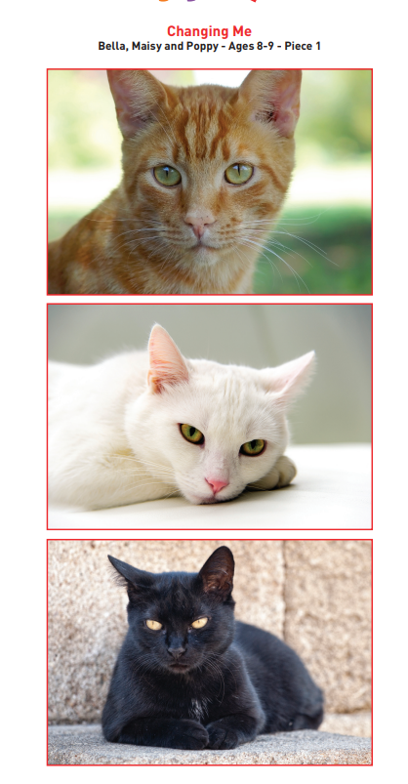
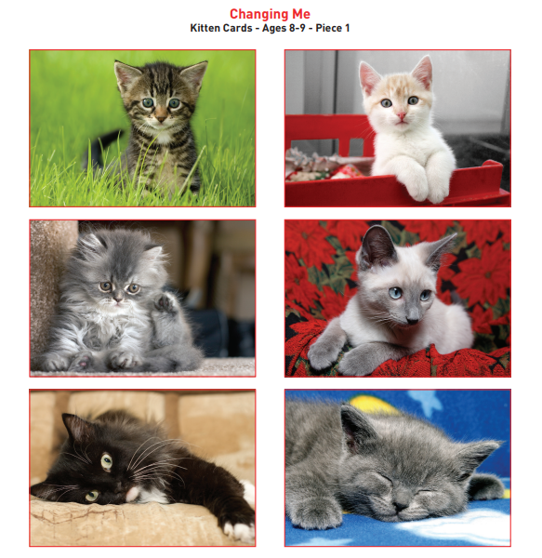
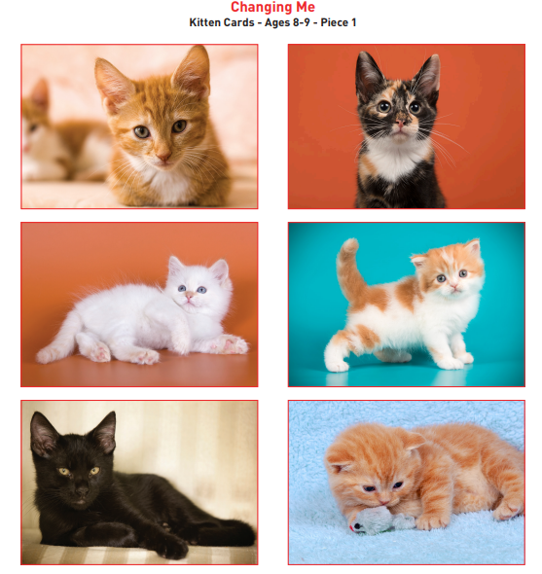
Piece 1 – Unique me

Slide 11
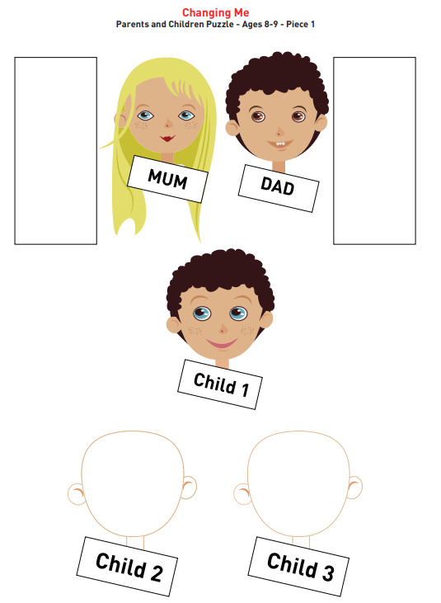
Piece 1
– Unique me

Slide 12
Piece 2 – Having a baby
Outcomes:
Correctly label the internal and external parts of male and female bodies that are necessary for making a baby.
Learning:
Understand that having a baby is a personal choice and express how I feel about having children when I am an adult.

Slide 13
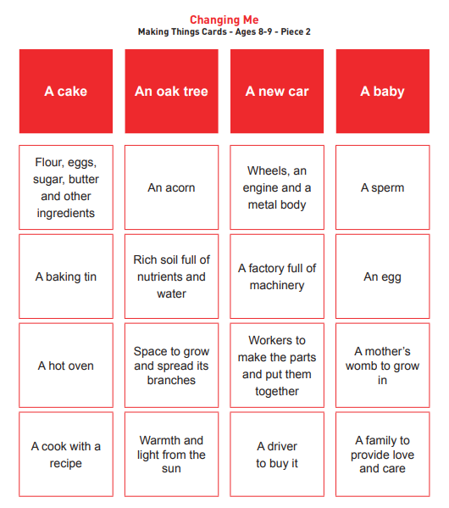
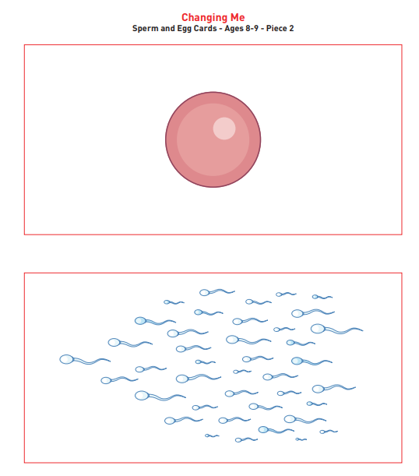
Piece 2 – Having a baby

Slide 14
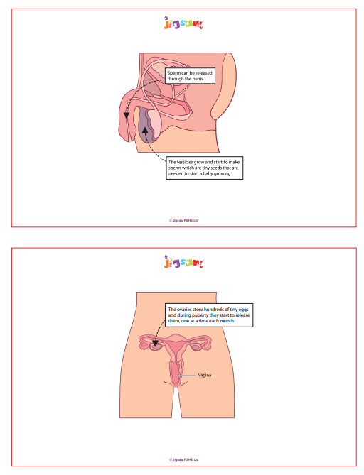
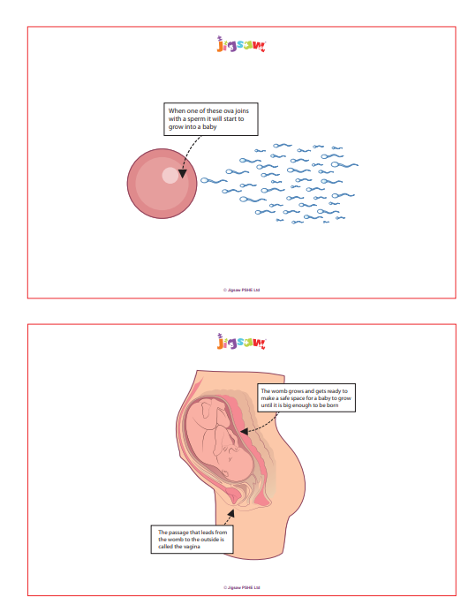
Piece 2 – Having a baby

Slide 15
Piece 3 – Girls and puberty
Outcomes:
Describe how a girl’s body changes in order for her to be able to have babies when she is an adult, and that menstruation (having periods) is a natural part of this.
Learning:
Know that I have strategies to help me cope with the physical and emotional changes I will experience during puberty.

Slide 16
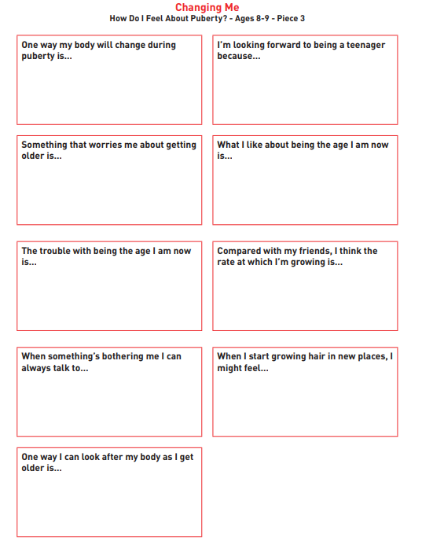
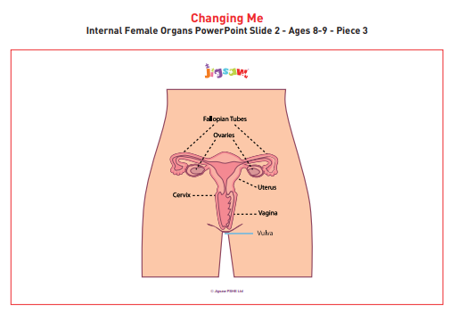
Piece 3 – Girls and puberty

Slide 17
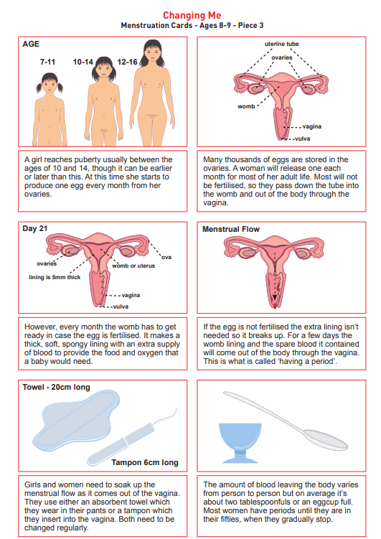
Piece 3 - Girls and puberty

Slide 18
Piece 4 – Circles of change
Outcomes:
Know how the circle of change works and can apply it to changes I want to make in my life.
Learning:
I am confident enough to try to make changes when I think they will benefit me.

Slide 19
Piece 4
– Circles of change

Slide 20
Piece 4
– Circles of change

Slide 21
Piece 4
– Circles of change
Notes:
One day after school, Sofia and Levi were called into the kitchen by their Dad who wanted a chat. Their Dad said he had met a new girlfriend and he wanted to get married to her. Their mum had left when they were little, so Dad had always looked after them on his own. Dad said his girlfriend was called Maria and she also had two children, so they would be one big happy family. Levi and Sofia weren’t so sure. They liked having Dad to themselves. Dad said he didn’t want to rush anything and said for now he just wanted them to get used to the idea and think about it for a while.

Slide 22
Piece 4
– Circles of change
Notes:
A week or two went by and Dad asked the children how they were feeling about Maria and her children. He asked if they were ready to meet them. Levi and Sofia thought they may as well get it over with and decided to say yes. Dad asked where they would like to go for a special day out, and suggested a theme park. Later that day Sofia said to Levi at least they would get to go somewhere cool even if Maria was going to be there.

Slide 23
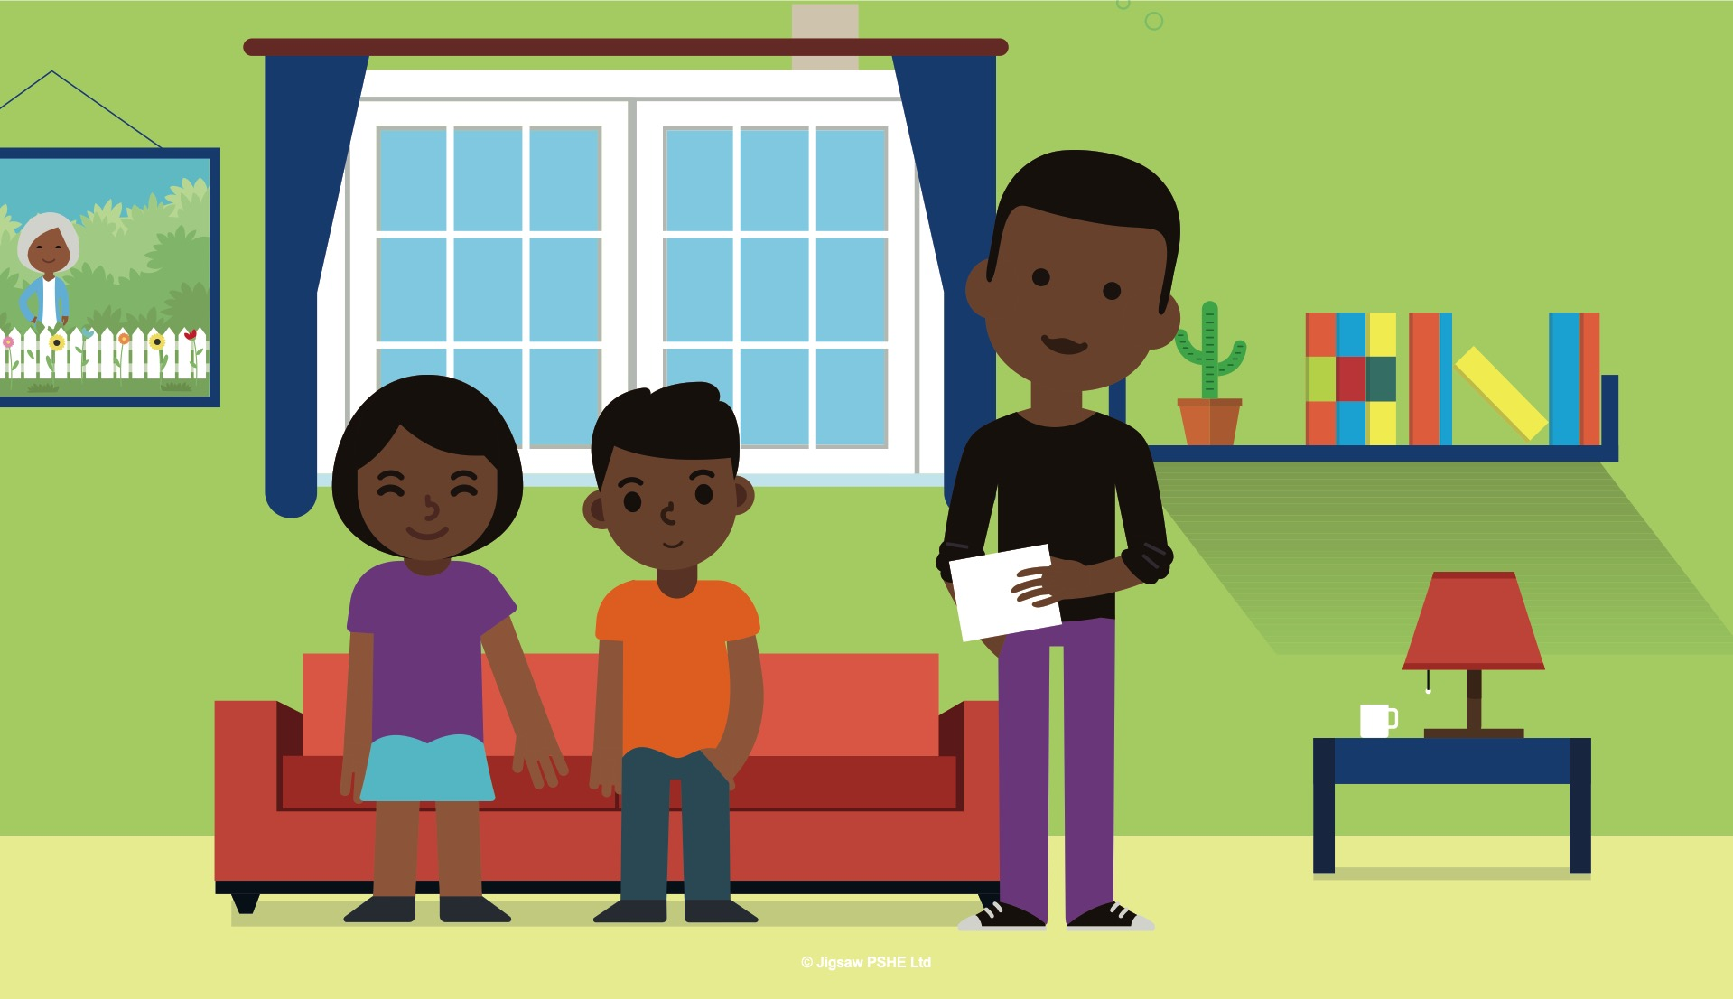
Piece 4
– Circles of change
Notes:
Two days before the trip, Dad sat down with Levi and Sofia and showed them some photographs of Maria and her children. He talked about them a lot so that Levi and Sofia were prepared before the trip. Sofia thought that Maria seemed kind, and they were both pleased to be getting an older brother and sister who were fun and caring.

Slide 24


Piece 4
– Circles of change
Notes:
The day of the trip arrived. The families met up. Maria and her children were very nice. Maria’s teenage children who were called Sam and Olivia, enjoyed taking Levi and Sofia on the scarier rides that their parents didn’t want to go on. Sam said that when they moved into the same house, he would teach Levi how to play basketball. Olivia said she was really looking forward to having a younger sister to share things with. Olivia was a blackbelt in Karate and she asked Sofia if she would like to start coming to classes with her. Sofia thought that would be great.

Slide 25
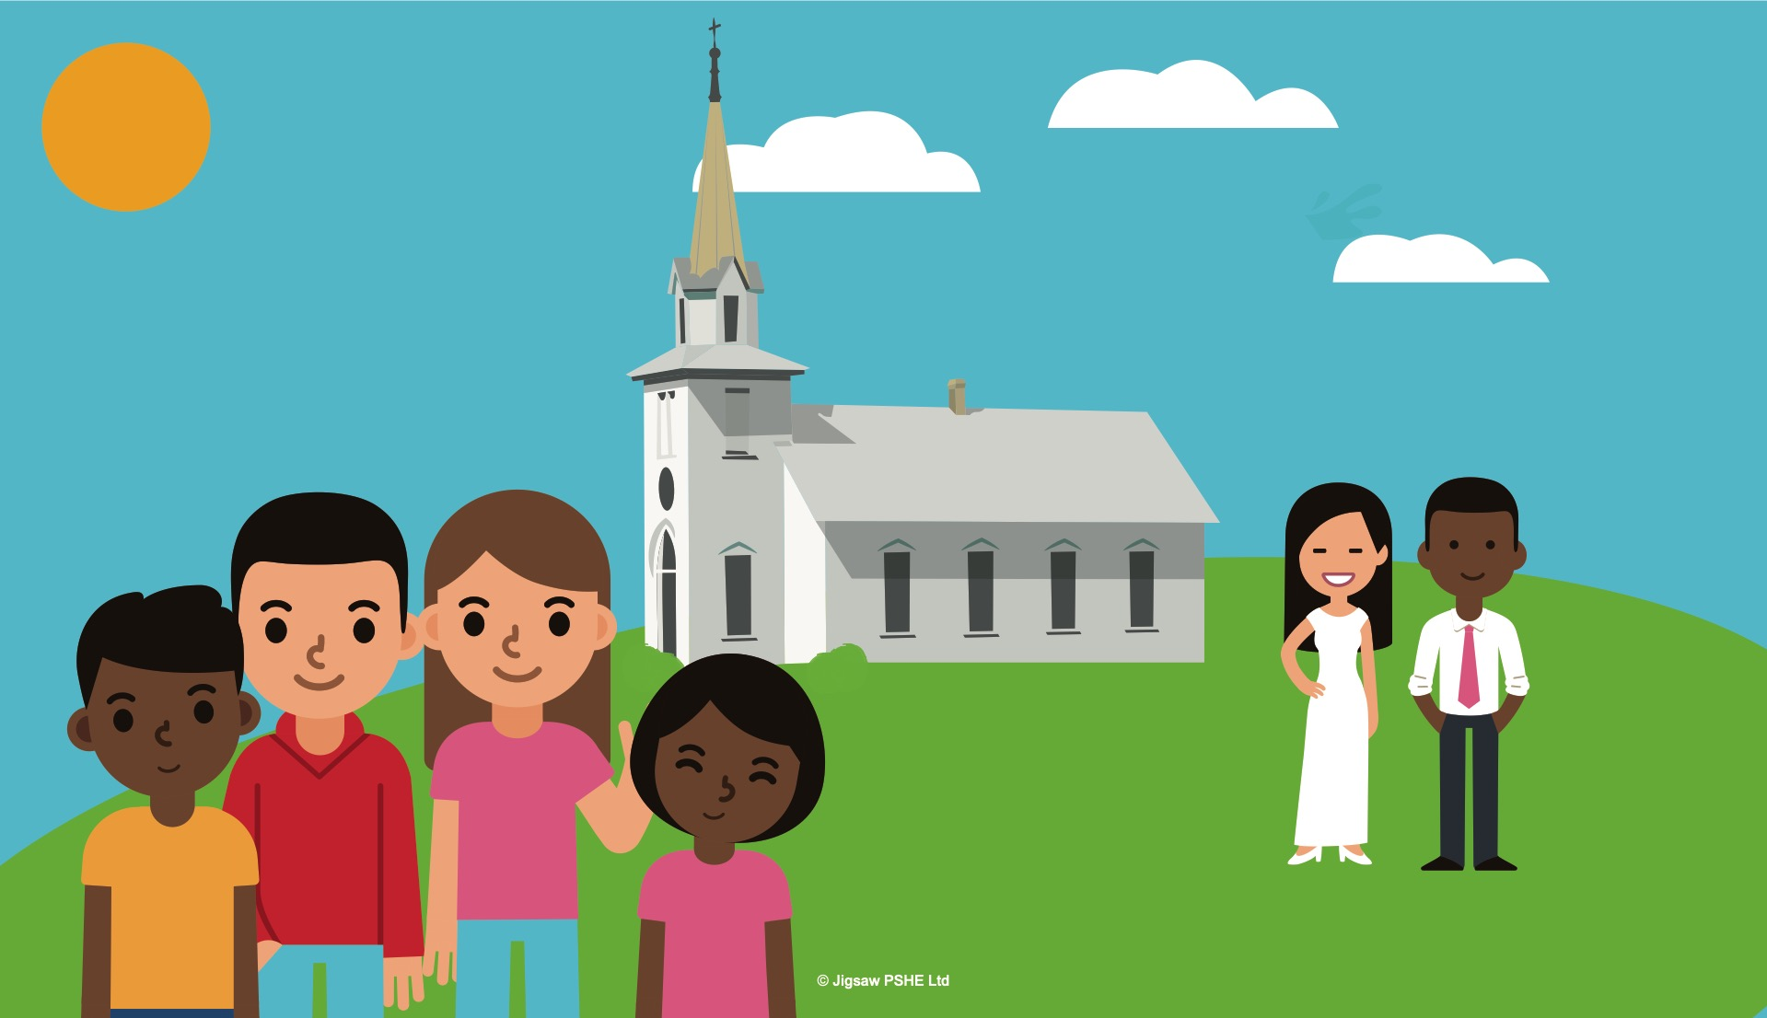
Piece 4
– Circles of change
Notes:
Over the next few weeks the two families met every weekend and slowly they began to change into one family. By the time of the wedding, it didn’t seem to Sofia and Levi at all strange their family had changed, and even though they sometimes felt a little nervous about having a new Mum, it didn’t seem anywhere near as scary compared to when their Dad had first told them.

Slide 26
Piece 4
– Circles of change

Slide 27
Piece 5 – Accepting change
Outcomes:
Identify changes that have been and may continue to be outside of my control that I learnt to accept.
Learning:
Express my fears and concerns about changes that are outside of my control and know how to manage these feelings positively.

Slide 28
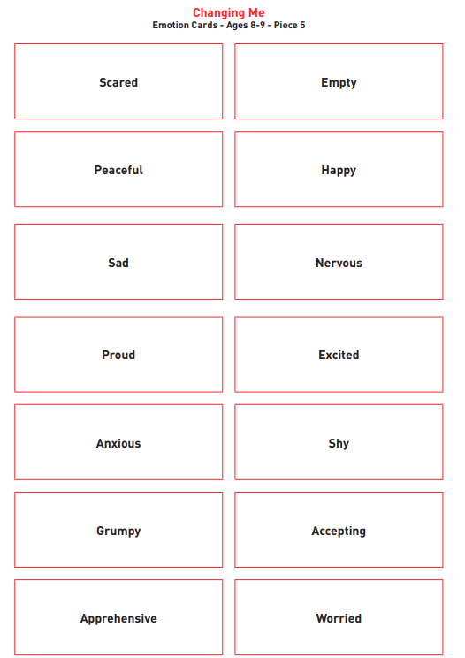
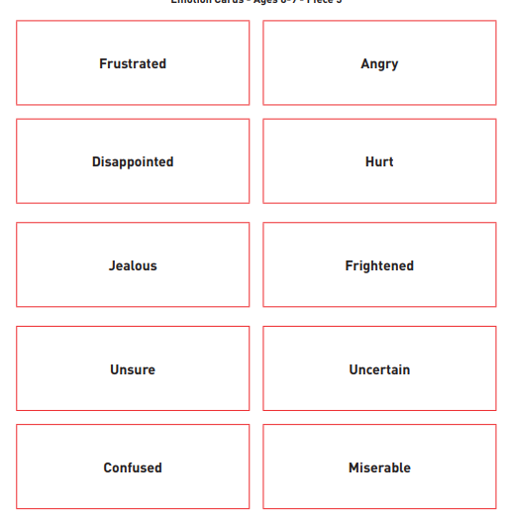
Piece 5
– Accepting change

Slide 29
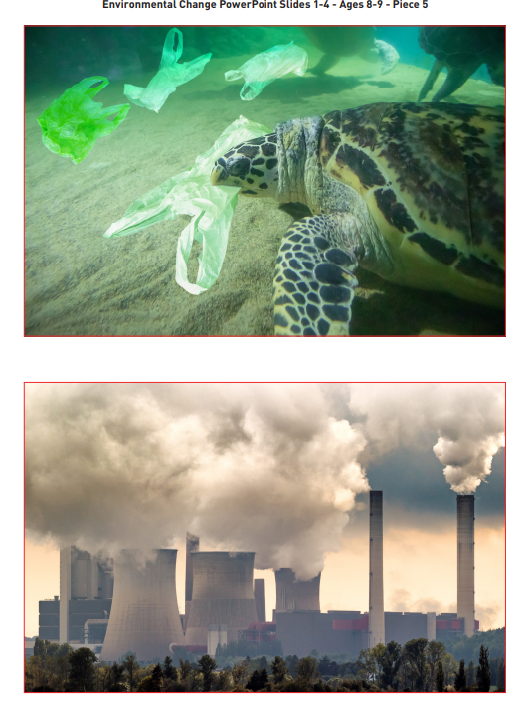
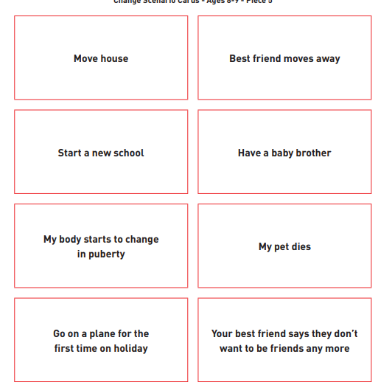
Piece 5
– Accepting change

Slide 30
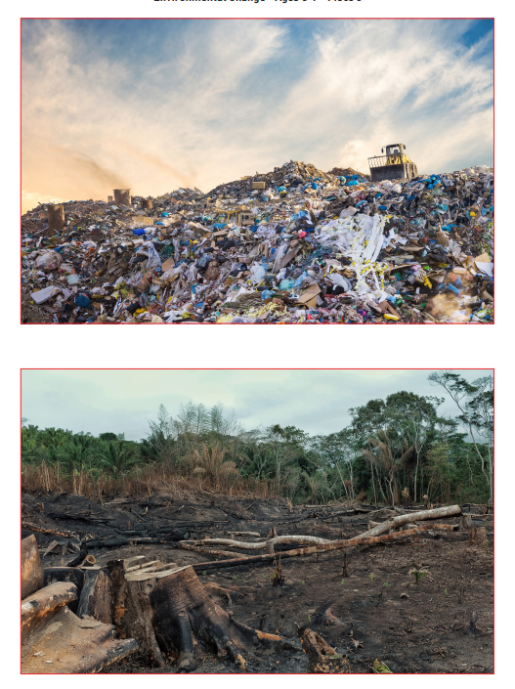
Piece 5
– Accepting change

Slide 31
Piece 6 – Looking ahead
Outcomes:
Identify what I am looking forward to when I move to a new class
Learning:
Reflect on the changes I would like to make next year and can describe how to go about this.

Slide 32
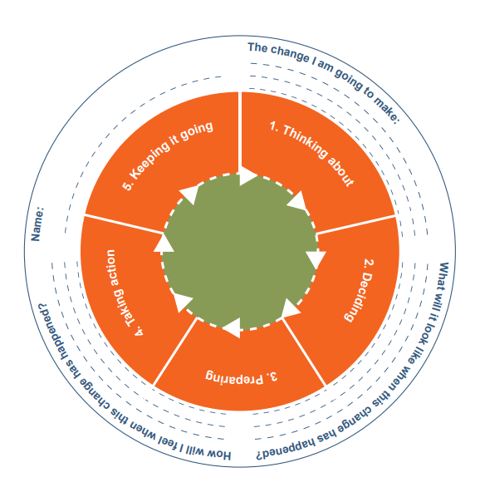
Piece 6 – Looking ahead

Slide 33
Can parents withdraw their children from RSE?
From September 2020…
(Government guidance 2019 page 17)
“Parents have the right to request that their child be withdrawn from some or all of sex education delivered as part of statutory RSE”.
NOT from Relationships or Health Education.
So, this session is to inform you of what this school defines as Sex Education,
what we intend to teach in RSHE and why…
…so you can make this decision.

Slide 34
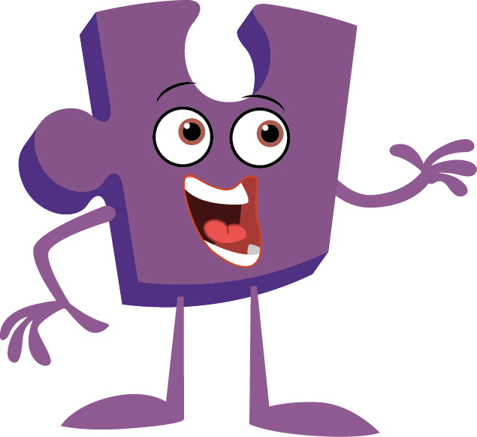

Any questions?

Slide 35

Thank you!

