Slide 1
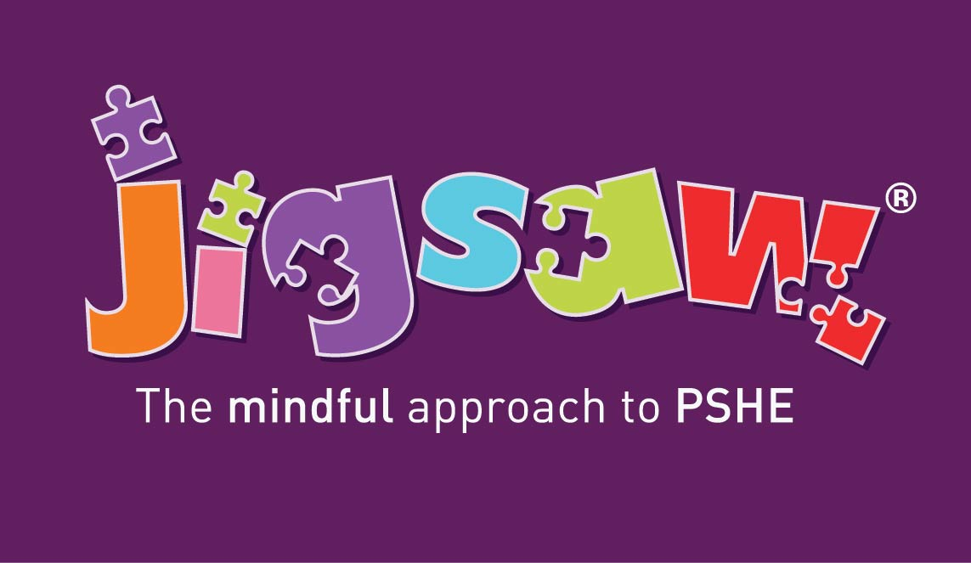
Consultation and Parental Engagement for RHSE
(Relationships, Sex AND Health Education)
How do we meet the statutory guidance in and make it meaningful for our school community?

Slide 2
This presentation outlines:
What the statutory expectations are for consultation and parental engagement on RSHE
Why this is important to your school community
How you can consult in a way that is meaningful for all
Where you can find additional support and information
Notes:
Welcome
Explain what the meeting is all about – they will hear technical language throughout the meeting as this will be the language that we will use when teaching the children. ‘We advise for you to continue to use this language at home as then the children will be more used to hearing the correct terminology for their intimate areas.’
They will have an opportunity to ask questions at the end of the meeting.

Slide 3
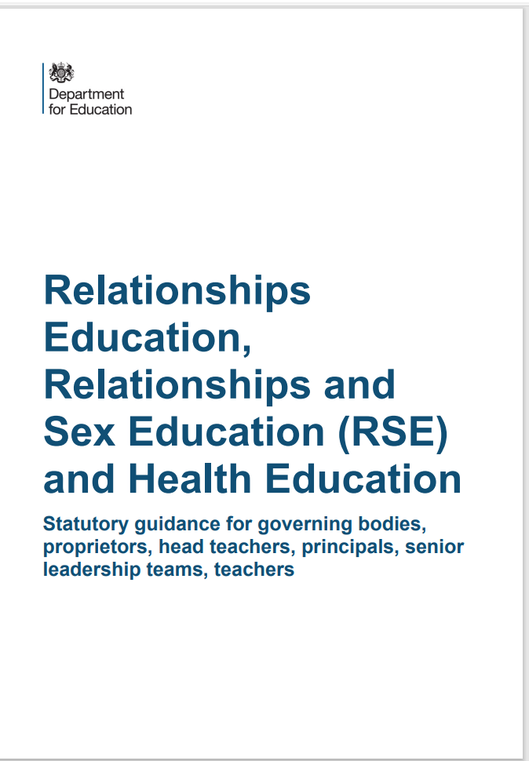
What do we have to consult on?
The DfE’s 2019 RSHE and RSE Guidance states in paragraph 13:
“All schools must have in place a written policy for Relationships Education and RSE. Schools must consult parents in developing and reviewing their policy. Schools should ensure that the policy meets the needs of pupils and parents and reflects the community they serve.”
Notes:
This is the statutory guidance given to us from the DfE.
“All schools must have in place a written policy for Relationships Education and RSE. Schools must consult parents in developing and reviewing their policy. Schools should ensure that the policy meets the needs of pupils and parents and reflects the community they serve.”
If you want to read this guidance there will be a link available on the powerpoint which will be added to the school’s website.

Slide 4
We don’t do this for other subjects. Why RSE?
Confidence
Staff, governors and parents need to feel comfortable talking about any issues that come up, and the context in which we are discussing them
Shared Responsibility
Children learn about Relationships and other topics in PSHE at home. We need to build in opportunities throughout the academic year for parents to be informed about the topics we cover in class – consultation can help us find out the best ways to do this. Parents can then prepare their child when they feel they need to and support them with any further questions beyond the lesson itself.
Sensitive Subjects
The topics we discuss in RSE – and PSHE – can sometimes be sensitive. Consultation enables us to carefully consider different views and seek consensus.
Mutual Respect
We need to listen to and respect the views of our parents and carers in the same way as we respect the views of their children in our classrooms and demonstrate how we encourage our pupils to do the same.
Reassurance
We need to explain what we are actually teaching in school, and what we are not teaching. The myths and misinformation in the media are leading to very real parental fear which we can dispel early BEFORE we teach these topics.
Notes:
The following reasons are why we ensure that you as parents understand what is being taught to your children.
Read Slide

Slide 5
Where you can find our policy and additional information
An updated copy of the RSE policy is available on the website for you to read through at your convenience.
We have also linked a copy to the DfE’s Statutory Guidance on the website in Curriculum and in PSHE.
Notes:
Read slide

Slide 6
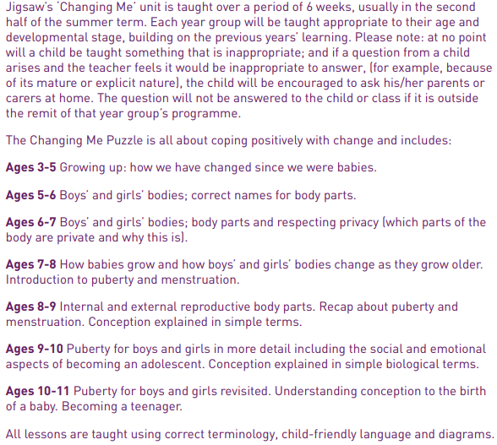
What will my child be taught about puberty and human reproduction? Progression from Early Years to Year 6.
Notes:
Explain how the children will be building on prior knowledge and it will become more technical as they progress through the school.

Slide 7
Puberty and Human Reproduction in Jigsaw 3-11 Changing Me Puzzle
FS | Growing Up | How we have changed since we were babies
Y1 | My changing body | Understanding that growing and changing is natural and happens to everybody at different rates
 | Boys’ and girls’ bodies | Appreciating the parts of the body that make us different and using the correct names for them
Y2 | The changing me | Where am I on the journey from young to old, and what changes can I be proud of?
 | Boys and girls | Differences between boys and girls – how do we feel about them? Which parts of me are private?
Y3 | Outside body changes | How our bodies need to change so they can make babies when we grow up – outside changes and how we feel about them
 | Inside body changes | How our bodies need to change so they can make babies when we grow up – inside changes and how we feel about them (animations used – shorter version Female and Male Reproductive Systems)
Notes:
ALL THIS FALLS WITHIN THE STATUTORY HEALTH EDUCATION GUIDANCE…changing adolescent body so is compulsory.
More detail about exactly what is covered in each year group.
Emphasise that only 2 or 3 lessons in every year group are specifically about either puberty (statutory) or How babies are made (not statutory).
Also emphasise that correct terminology is introduced early so the school can meet its safeguarding obligations and to get the children used to using the words appropriately (ie we also teach them when it’s appropriate to use these words and when not). A further rationale for this is that in KS2, body part words are not seen as something rude or dirty.
Puberty is introduced very gently in Y3 because some girls may start their periods early and it is necessary to prepare them for this so they aren’t scared or worried.

Slide 8
Puberty and Human Reproduction in Jigsaw 3-11 Changing Me Puzzle
Y4 | Having a baby | The choice to have a baby, the parts of men and women that make babies and – in simple terms – how this happens (animations used – the Female Reproductive System)
 | Girls and puberty | How a girl’s body changes so that she can have a baby when she’s an adult – including menstruation (animations used – the Female Reproductive System)
Y5 | Puberty for girls | Physical changes and feelings about them – importance of looking after yourself (animations used – the Female Reproductive System)
 | Puberty for boys | Developing understanding of changes for both sexes – reassurance and exploring feelings (animations used – the Male Reproductive System)
 | Conception | Understanding the place of sexual intercourse in a relationship and how it can lead to conception and the wonder of a new life (animations used – the Female and Male Reproductive Systems)
Y6 | Puberty | Consolidating understanding of physical and emotional changes and how they affect us (animations used – the Female and Male Reproductive Systems)
 | Girl talk / boy talk | A chance to ask questions and reflect (single sex) (animations used – the Female and Male Reproductive Systems)
 | Conception to birth | The story of pregnancy and birth (animations used – the Female and Male Reproductive Systems)
Notes:
Conception is introduced age appropriately in Y4 in the context of why our bodies change during puberty.
THERE IS AN ALTERNATIVE LESSON AVAILABLE IN YEAR 4 FOR SCHOOLS WHO DO NOT WISH TO TEACH THIS IN YEAR 4. If you decide not to teach conception in year 4, remember to change this slide!
Note that one lesson in Y4 is called Puberty for girls, this doesn’t exclude the boys, it covers them too, but the main focus is on menstruation.
Conception and puberty is built upon in Year 5 and then puberty, conception and childbirth is covered in more detail (but still age-appropriately) in Y6 with a chance for single gender group lessons (up until this point lesson shave all been mixed gender).
Remind the parents/carers that when moving to secondary school Sex Ed is compulsory so there is an expectation that children will be moving into Y7 with some knowledge.
The lessons that are highlighted are the only lessons that can be opted out of. In year 3 ALL LESSONS ARE MANDATORY

Slide 9
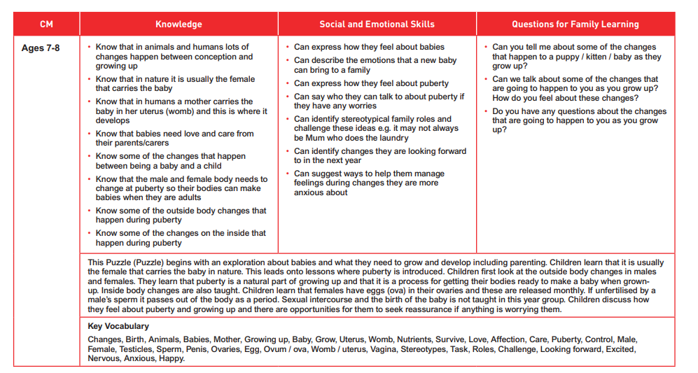
Notes:
Explain the vocabulary that the children will learn and that it will be the language used within the lessons as this is the correct terminology.

Slide 10
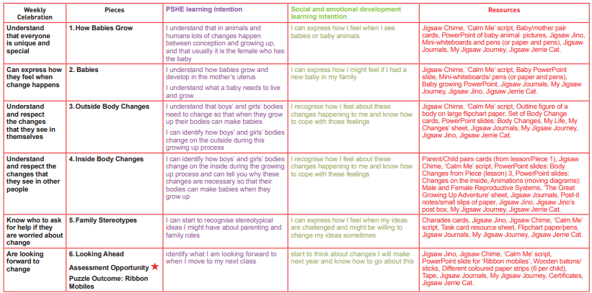
Year 3 Weekly Plan
Notes:
This is how it will be broken down.

Slide 11
Piece 1 – How Babies Grow
Outcomes:
Understand that in animals and humans lots of changes happen between conception and growing up, and that usually it is the female who has the baby
Express how I feel when I see babies or baby animals
Learning:
To understand the requirements for caring for a child.
To begin to understand the roles of a child's parents.
Notes:
This will be the first lesson that the children will have as part of the Changing Me topic.

Slide 12
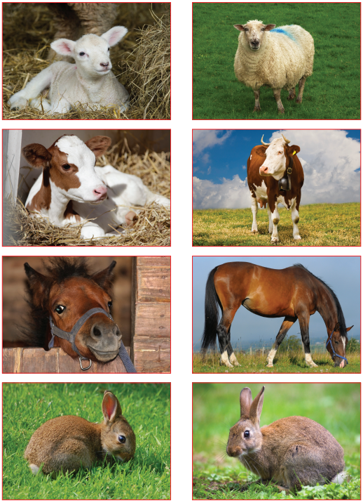
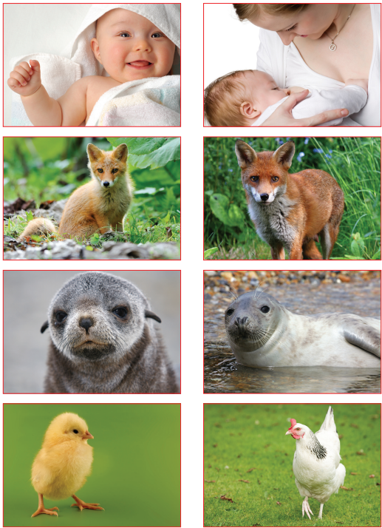
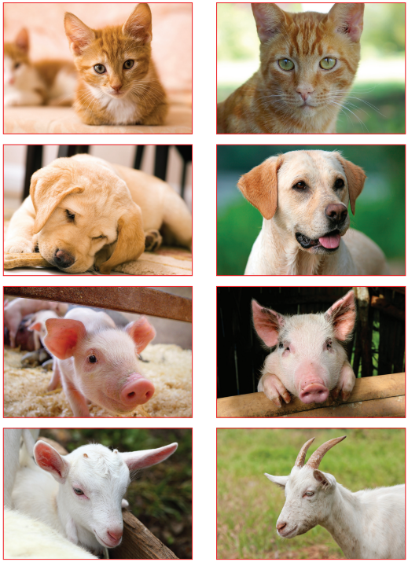
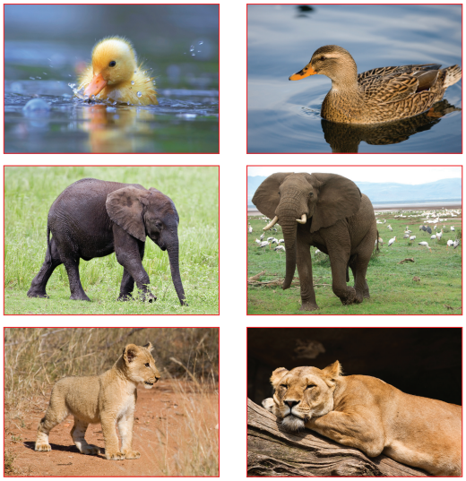
Piece 1 - Images
Notes:
These are the images that they will see and the children will be matching the infant to the adult.

Slide 13
Piece 2 – Babies
Outcomes:
Understand how babies grow and develop in the mother’s uterus and understand what a baby needs to live and grow.
Express how I might feel if I had a new baby in my family
Learning:
Children will be taught what are the needs of a baby in order to grow and survive in early life
Children will then discuss about when life starts and learn that a baby begins its life in the womb.
Notes:
Lesson 2 – WE WILL NOT BE MENTIONING CONCEPTION AT THIS POINT

Slide 14
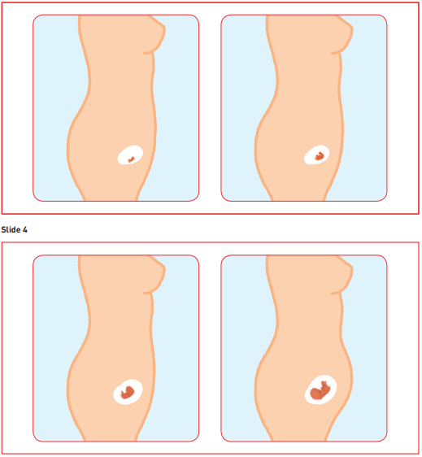
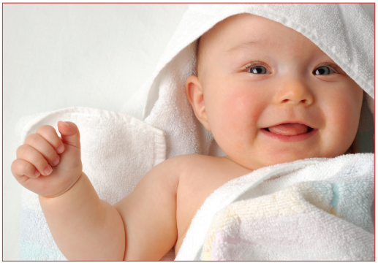
Piece 2 - Images
Notes:
These are the images that they will see and the children will be seeing how a baby develops in utero.

Slide 15
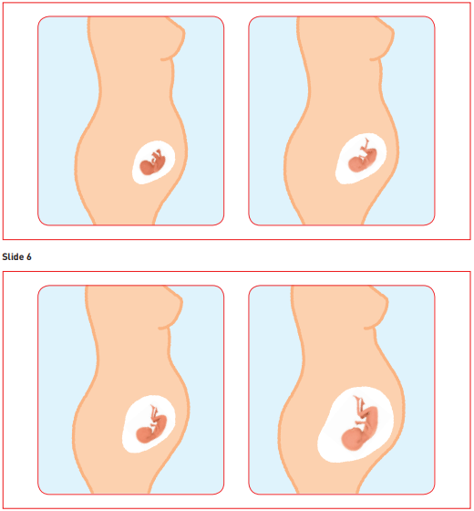
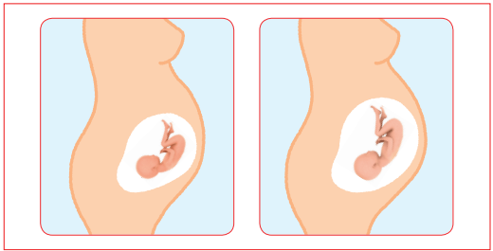
Piece 2 - Images
Notes:
These are the images that they will see and the children will be seeing how a baby develops in utero.

Slide 16
Piece 3 – Outside body changes
Outcomes:
Understand that boys’ and girls’ bodies need to change so that when they grow up their bodies can make babies.
Identify how boys’ and girls’ bodies change on the outside during this growing up process.
Recognise how I feel about these changes happening to me and how to cope with those feelings.
Learning:
Children will be taught how both the male and female body changes during puberty.
Children will understand that they will be going through changes and how some changes can be controlled, and others can’t.
Notes:
Lesson 3 – this will be focussing on external changes to their bodies and introducing the term puberty – we will not be mentioning internal changes such as periods/menstruation in this lesson

Slide 17
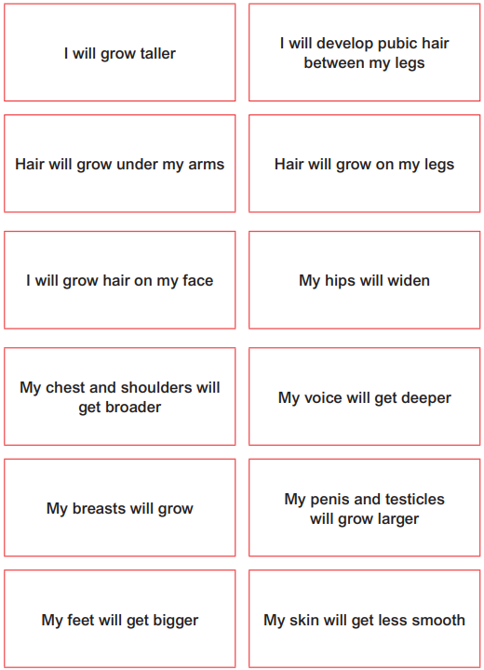
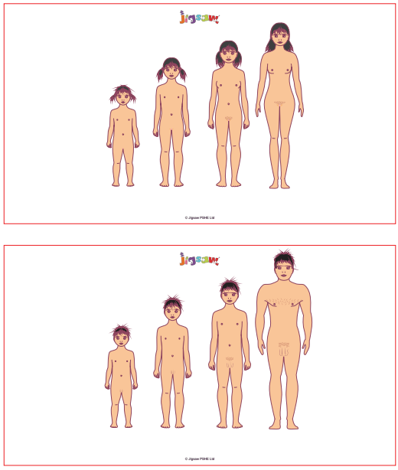
Piece 3 - Images
Notes:
These are the images that they will see and the children will be comparing external changes over time within a male and a female body.

Slide 18
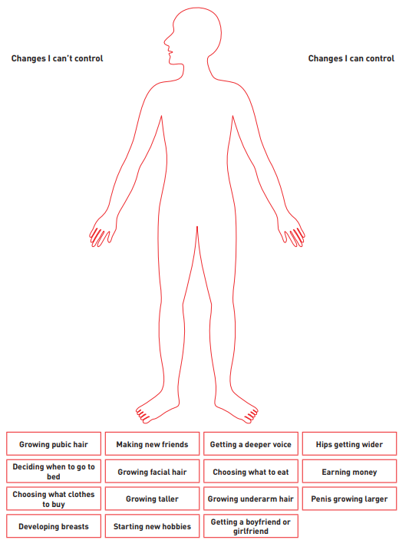
Piece 3 - Images
Notes:
With this they will be learning how they cannot control everything that changes within their bodies and helping them to understand that they will still have control of other aspects of their development as they grow.

Slide 19
Piece 4 – Inside body changes
Outcomes:
Identify how boys’ and girls’ body change on the inside during the growing up process and why these changed are necessary so that their bodies can make babies when they grow up
Recognise how I feel about these changes happening to me and how to cope with those feelings.
Learning:
The children will be learning about the different cells that are produced by males and females during and after puberty (eggs and sperm) and that these need to combine for a baby to be made.
Notes:
Lesson 4 - This lesson does not attempt any explanation of how the sperm and the egg come together. It is likely that the question may come up, though. In that case you may choose just to say that that’s another special bit about making a baby, and we’re saving up learning about it until later; or you may want to give a simple answer along the lines that the Mum and Dad choose when they want that to happen and the sperm meets the egg when the mum and dad have a special grown up cuddle called sexual intercourse. Even if offering little explanation, be upbeat and positive about it; avoid, if you can, making it seem like a guilty secret.
As a year group team, we will say that the children will learn about how that happens later or that they can speak to their caregivers – We will not mention ‘sexual intercourse’ at this time.
This will be the time when we mention about periods/ menstruation but not cover menstrual products. We will also give the children an opportunity to ask questions privately via the worry monster and post-its – we will ask the children to put their names on the post-its however they will remain anonymous to the rest of the class. .

Slide 20
Piece 4 - Images
Notes:
These are the images that they will see and the children will be matching the infant to the adult.

Slide 21
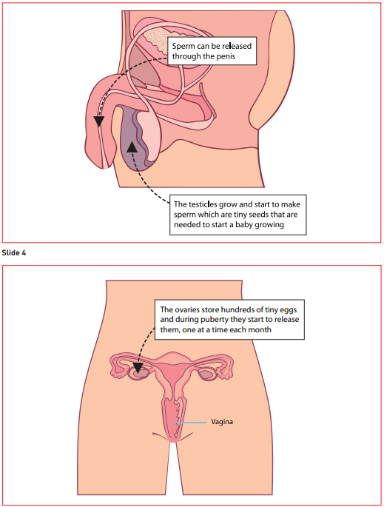
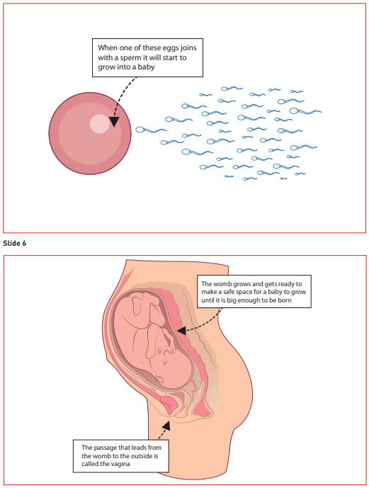
Piece 4 - Images
Notes:
These are the images that they will see and the children will recap external changes before learning about internal changes and the basics of the conception of a child – REITERATE THAT SEXUAL INTERCOURSE WILL NOT BE MENTIONED.

Slide 22
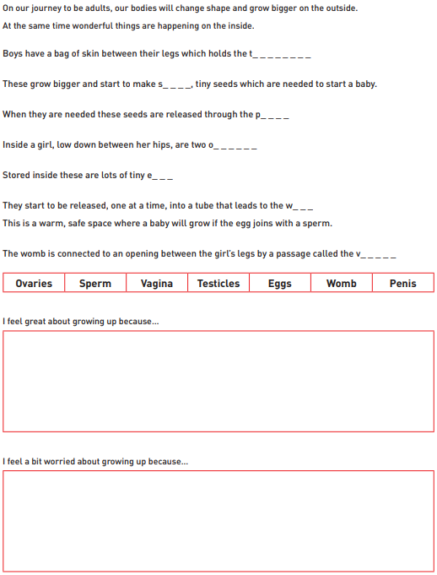
Piece 4 - Images
Notes:
This is the activity that they will be completing

Slide 23
Piece 5 – Family Stereotypes
Outcomes:
start to recognise stereotypical ideas I might have about parenting and family roles
express how I feel when my ideas are challenged and be willing to change my ideas sometimes
Learning:
Discussion about gender roles within a relationship and family life.
Discussion about gender stereotyping and what that means.
Notes:
Lesson 5 – They will be learning about stereotypical gender roles and stereotyping used in the media to advertise to boys/girls through the use of designs and colours.

Slide 24
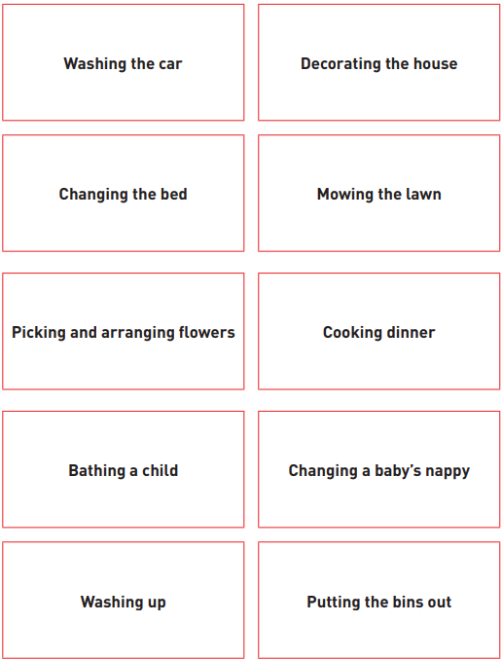
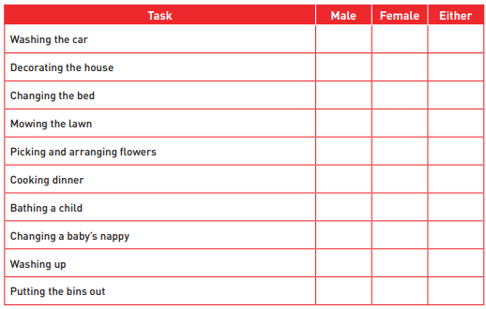
Piece 5 - Images
Notes:
These are the tasks that they will be assigning according to gender.

Slide 25
Piece 6 – Looking ahead to Year 4
Outcomes:
Identify what I am looking forward to when I move to my next class
start to think about changes I will make next year and know how to go about this
Learning:
Discussion about what we’re looking forward to and why we might be a little nervous
Notes:
Final lesson – this will be helping the children prepare themselves for year 4 and the challenges/worries that they may have about the move to year 4

Slide 26
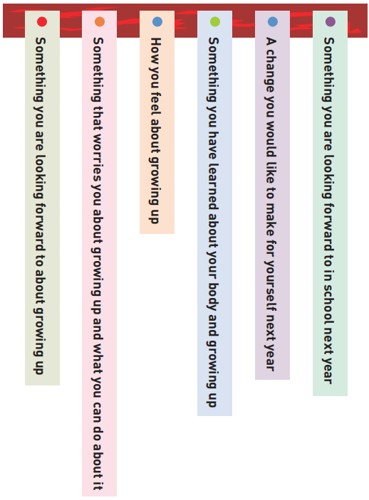
Piece 6 - Images
Notes:
They will be creating this mobile with each strip of paper writing down the answers to these prompts.

Slide 27
Can parents withdraw their children from RSE?
From September 2020…
(Government guidance 2019 page 17)
“Parents have the right to request that their child be withdrawn from some or all of sex education delivered as part of statutory RSE”.
NOT from Relationships or Health Education.
So, this session is to inform you of what this school defines as Sex Education,
what we intend to teach in RSHE and why…
…so you can make this decision.
Notes:
There are only the 3 lessons (one in year 4, one in 5 and one in 6) that the children can be withdrawn from as the rest are compulsory under the RSE curriculum.

Slide 28


Any questions?
Notes:
Feel free to come and talk to us privately if you don’t want to ask in front of others.

Slide 29

Thank you!

